Slide 1

Frontiers of Network Science
Fall 2024
Class 4B: Random Networks
(Chapter 3 in Textbook)
Boleslaw Szymanski
based on slides by Albert-László Barabási & Roberta Sinatra

Slide 2
Section 1
Introduction to
Random Networks
Network Science: Random Networks

Slide 3
RANDOM NETWORK MODEL
Network Science: Random Networks
Notes:
Imagine organizing a party for a hundred guests who do not know each other. Offer them wine and cheese, and soon you will see thirty to forty chatting groups of two to three. Now mention to a guest that the red wine in the unlabeled dark green bottles is a rare vintage, better than that with the red label. Ask him to share this information only with his acquaintances and you know that your expensive wine is fairly safe, because your guest has only had time to meet two or three people in the room. However, inevitably the guests will mix, joining other groups and with subtle invisible paths will start connecting people that may still be strangers to each other. For example, while John has not met Mary yet, they have both met Mike, and so there is an invisible path from John to Mary through Mike. As time goes on, the guests will be increasingly interwoven by such intangible links. With that the identity of the expensive wine moves from a tiny group of insiders to more and more chatting groups. To be sure, when all guests had gotten to know each other, everybody would be pouring the superior wine. But if each encounter took only ten minutes, meeting all ninety-nine others would take about sixteen hours. Thus, you could reasonably hope that a few drops of the better wine would be left at the end of the party.
Yet, you would not be more wrong and the purpose of this chapter is to show why. We will see that this problem maps into a classic problem in network science, leading us to the concept of random networks. In turn random network theory will tell us that we do not have to wait until all individuals get to know each other to endanger our expensive wine. Rather, after each person meets at least one other guest, you may find yourself tipping an empty bottle into your expectant glass as everybody could be drinking the reserve wine.

Slide 4
Section 3.2
The random network model
Network Science: Random Networks

Slide 5
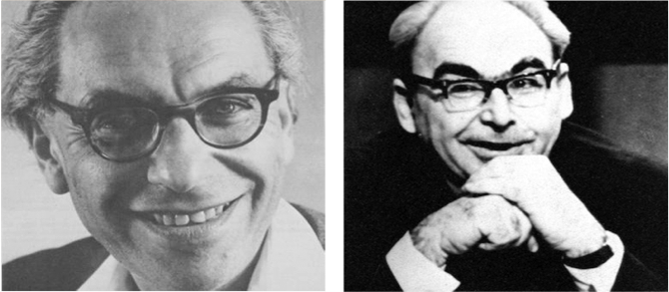
RANDOM NETWORK MODEL
Pál Erdös
(1913-1996)
Alfréd Rényi
(1921-1970)
Erdös-Rényi model (1960)
Connect with probability p
p=1/6 N=10
<k> ~ 1.5
Network Science: Random Networks

Slide 6
RANDOM NETWORK MODEL
Definition:
A random graph is a graph of N nodes where each pair of nodes is connected by probability p.
Network Science: Random Networks

Slide 7
RANDOM NETWORK MODEL
p=1/6
N=12
L=8
L=10
L=7
Network Science: Random Networks

Slide 8
RANDOM NETWORK MODEL
p=0.03
N=100
Network Science: Random Networks
Notes:
Does look like a real network, does it not?

Slide 9
Section 3.3
The number of links is variable
Network Science: Random Networks

Slide 10
RANDOM NETWORK MODEL
p=1/6
N=12
L=8
L=10
L=7
Network Science: Random Networks

Slide 11
RANDOM NETWORK MODEL
p=0.03
N=100
Network Science: Random Networks
Notes:
Does look like a real network, does it not?

Slide 12
Section 3.3
The number of links is variable
Network Science: Random Networks

Slide 13
RANDOM NETWORK MODEL
p=1/6
N=12
L=8
L=10
L=7
Network Science: Random Networks

Slide 14
Number of links in a random network
P(L): the probability to have exactly L links in a network of N nodes and probability p:
The maximum number of links in a network of N nodes.
Binomial distribution...
Number of different ways we can choose L links among all potential links.
Network Science: Random Networks

Slide 15
MATH TUTORIAL Binomial Distribution: The bottom line
http://keral2008.blogspot.com/2008/10/derivation-of-mean-and-variance-of.html
Network Science: Random Networks

Slide 16
RANDOM NETWORK MODEL
P(L): the probability to have a network of exactly L links
The average number of links <L> in a random graph
The standard deviation
Network Science: Random Networks
Notes:
Increasing p increases the average number of links increases linearly from L = 0 to L_{max} and the average degree of a node from $\langle k \rangle =0$ to $\langle k \rangle = N-1$ (
. Hence the larger $p$ is, the denser is the network.

Slide 17
Section 3.4
Degree distribution
Network Science: Random Networks

Slide 18
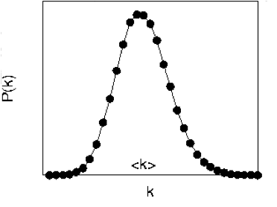
DEGREE DISTRIBUTION OF A RANDOM GRAPH
Select k
nodes from N-1
probability of
missing N-1-k
edges
probability of
having k edges
As the network size increases, the distribution becomes increasingly narrow—we are increasingly confident that the degree of a node is in the vicinity of <k>.
Network Science: Random Networks

Slide 19
DEGREE DISTRIBUTION OF A RANDOM GRAPH
For large N and small k, we can use the following approximations:
for
Network Science: Random Networks

Slide 20
POISSON DEGREE DISTRIBUTION
For large N and small k, we arrive at the Poisson distribution:
Network Science: Random Networks

Slide 21
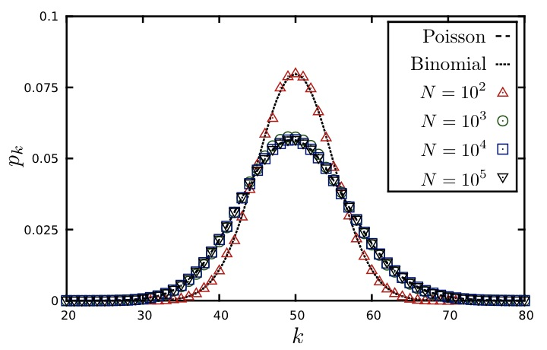
DEGREE DISTRIBUTION OF A RANDOM GRAPH
<k>=50
P(k)
k
Network Science: Random Networks
Notes:
Note that the exact result for the degree distribution in the binomial form (\ref{P_K}) and (\ref{E-RG-Poisson}) represents only an approximation to (\ref{P_K}) for large $N$. Yet, for $k<<N$, there is no fundamental difference between (\ref{P_K}) and (\ref{E-RG-Poisson}), the Poisson form (\ref{E-RG-Poisson}) simply represents a different way to write (\ref{P_K}) in this limit. The advantage of the Poisson form is that (\ref{E-RG-Poisson}) it does not explicitly depend on the number of nodes $N$. Therefore, it predicts us that the degree distributions of random networks with the same average degree, $\langle k \rangle$, but different sizes, are indistinguishable from each other. This is illustrated in Figure \ref{F-RG-PoissonNDependence}, where we show the degree distribution of several random networks of different sizes, $N$. The figure indicates that while for small $N$ there are differences between the numerically obtained $p_k$ and (\ref{E-RG-Poisson}), for large $N$ the differences vanish and the degree distribution becomes independent of the system
size. \\

